Slide 1
Optimizing Individual Nutrition in Preterm Infants: Randomized Clinical Trial (RCT)
Luc P. Brion,¹ Charles R. Rosenfeld,¹ Roy Heyne,¹
L. Steven Brown,² Cheryl Lair,² Maria Caraig¹
^{1.} University of Texas Southwestern Medical Center ^{2.} Parkland Health & Hospital Systems
Dallas, TX

Slide 2
Disclosure Statement
None of the authors has any financial relationship.
There was no real or apparent conflict of interest related to the content of this presentation.
This study was funded by:
Children's Foundation (LPB)
Gerber Foundation (LPB)
George L. MacGregor Professorship (CRR).
The funding organizations had no role in design and conduct of the study; collection, management, analysis and interpretation of the data; preparation, review and approval of this presentation.

Slide 3
Background
In preterm infants fed human milk, milk fortification can be adjusted by:
optimization, based on growth rate and serum analyses of nutrients, and/or
individualization or targeting, based on serial human milk nutrient analyses.
Four previous randomized trials reported improvement of growth, two with optimization and two with individualized or targeted fortification.
A quality improvement project preceded the current RCT in order to standardize anthropometric measurements.

Slide 4
Primary Objective (in PICO Format: Patients, Intervention, Comparison, Outcome)
The 1st specific aim of this RCT was to determine whether:
P:
Neonates <29 wks gestational age (GA) and
Small for GA (SGA, birthweight <10th centile for GA) neonates 29-34 wks
I: individualized and optimized nutrition (experimental)
in the neonatal intensive care unit (NICU)
C: compared with optimized nutrition (controls)
O: results in improved growth to
36 wks postmenstrual age or
discharge (if discharged before 36 wks)

Slide 5
Objectives (cont’d)
The 2nd specific aim was to determine if individualized and optimized nutrition in the NICU reduces the risk of disproportionate growth (body mass index [BMI]>90th centile) at 36 wks postmenstrual age or discharge.

Slide 6
Design
Double-blinded parallel group RCT
Randomization using random block allocation
Stratification by GA and size for age at birth
Appropriate/Large for GA 23-28 wks
SGA 23-28 wks
SGA 29-34 wks
Date of birth: 01/27/2016-9/10/2018

Slide 7
Patient Population
Eligibility criteria:
Preterm infants <29 wks GA and SGA infants <35 wks GA born at Parkland Hospital
Maternal plan to breastfeed or to use milk from the donor milk bank
From birth to 1 wk of life
Exclusion criteria:
Patients on comfort care
Patients with major congenital abnormalities
Patients who are too unstable for the first 7 d to have an accurate length measurement

Slide 8
Intervention
Controls
Milk fortification optimized weekly by clinical team based on serum analyses of nutrients, weight gain and linear growth
Experimental group
Breast milk macronutrients
adjusted daily by formula technicians based on nutrient measurements using near-infrared spectroscopy (NIRS)
aiming at concentrations similar to averages in donor milk
these adjustments were blinded to clinical and study teams.
In addition, milk fortification was optimized weekly as in controls

Slide 9
Measurements of Breast Milk Nutrients and Supplementation
Measurements:
SprectraStarTM 2500 XL Calais Neonatal Analyzer (Unity Scientific, Brookfield, CT)
Yearly calibration by the company
To improve accuracy and precision (Fusch 2015): Calibration every 6 mon for bias and slope against bench laboratory measurements on 10 samples from Ohio Human Milk Bank
In triplicate or duplicate
Supplementation:
Microlipid (safflower oil) to 3.2 gm/100 ml
Beneprotein to 1.16 gm/100 ml
Polycal to 7.8 gm/100 ml

Slide 10
Outcomes Measured at Endpoint (36 wks Postmenstrual Age or Discharge)
Primary outcomes:
Weight gain velocity (Patel) in gm x kg⁻¹ x day⁻¹
Linear growth velocity in cm x week⁻¹
Assessed using validated methods (length board or caliper)
Secondary outcome:
Disproportionate growth, defined as:
body mass index [BMI]>90th centile

Slide 11
Statistics and Sample Size
Continuous variables were analyzed using Student t-test, Mann-Whitney test, or analysis of variance adjusting for interaction of treatment and stratification.
Sample size was calculated to yield:
80% power using 2-tailed Student t-test (alpha error 0.025) to detect an increase in weight gain velocity by
2 g x kg⁻¹ x day⁻¹ (standard deviation 3 g x kg⁻¹ x day⁻¹)
95% power (alpha error 0.001) to detect an increase in length velocity by
0.2 cm x week⁻¹ (standard deviation 0.2 cm x week⁻¹),
taking into account clustering due to twins and multiples.
A sample size of 100 patients had >80% power for both primary outcomes.

Slide 12
Approval and Safety
Registered at ClinicalTrials.gov NCT02372136
Approved by
The IRB of UT Southwestern Medical Center
Parkland Health & Hospital Systems
Non-FDA approved NIRS device classified as low risk by the IRB
Data Safety Monitoring Committee reviewed predetermined adverse events (death, necrotizing enterocolitis, feeding intolerance, sepsis) every 6 mon.

Slide 13
The Consort Flow Diagram
Assessed for eligibility (n=293)
Excluded (n=173)
Not approached (n= 63)
Refused (n= 110)
Enrollment
Randomized (n=120)
Control (n=58)
Received allocated
intervention (n=58)
Experimental (n=62)
Received allocated
intervention (=62)
Allocation
Weight: Analyzed (n=57)
1 death before 36 weeks
Length: Analyzed (n=55)
1 death before 36 weeks
Additional missing (n=2): incomplete measurements
Weight: Analyzed (n=59)
3 deaths before 36 weeks
Length: Analyzed (n=52)
3 deaths before 36 weeks
Additional missing (n=7): incomplete measurements
36 weeks or Discharge Analysis

Slide 14
Baseline Neonatal Characteristics
Variable | Controls (n=58) | Experimental (n=62) | P
Gestational age (wks) | 28 ± 3 | 28 ± 3 | 0.49
Female (%) | 33 (57) | 31 (50) | 0.45
Strata 23-28 weeks GA AGA or LGA 23-28 weeks GA SGA 29-34 weeks SGA | 41 (71) 4 (7) 13 (22) | 46 (75) 3 (5) 12 (20) | 0.82
Race/ethnicity Hispanic Non-Hispanic African-American Non-Hispanic White Other | 39 (67) 27 (29) 1 (2) 1 (2) | 41 (66) 17 (27) 4 (7) 0 (0) | 0.44
Birth weight (grams) | 1034 ± 294 | 1024 ± 304 | 0.84
Birth Length (cm) | 35.5 ± 3.4 (n=57) | 35.6 ± 3.6 (n=59) | 0.84
Fronto-occipital circumference (FOC) (cm) | 24.9 ± 2.5 | 24.7 ± 2.4 | 0.72
Body Mass Index (BMI) (kg x m⁻²) | 7.9 ± 1.0 (n=57) | 8.0 ± 1.0 (n=59) | 0.81
Antenatal steroids | 53 (91) | 53 (86) | 0.32
Pregnancy-induced hypertension | 24 (41) | 22 (36) | 0.51
Maternal diabetes mellitus | 10 (17) | 5 (8) | 0.13
Congenital anomaly | 11 (19) | 7 (11) | 0.24

Slide 15
Growth Assessment at Endpoint
Variable | Controls | Experimental | P unadjusted | P adjusted **
Weight gain velocity (g x kg⁻¹ x day⁻¹) | 13.1 ± 2.1 (n=57) | 13.0 ± 2.6 (n=59) | 0.87 | 0.24
Linear growth velocity (cm x week⁻¹) | 0.9 ± 0.2 (n=55) | 0.9 ± 0.2 (n=52) | 0.90 | 0.10
BMI > 90th centile | 1 (2) (n=55) | 1 (2) (n=53) | 1.00 | 1.00
Weight (grams) | 2121 ± 420 (n=57) | 2157 ± 394 (n=59) | 0.63 | 0.75
Weight Z-score | -1.2 ± 0.8 (n=55) | -1.0 ± 0.9 (n=58) | 0.45 | 0.64
Length (cm) | 42.8 ± 2.9 (n=55) | 43.0 ± 2.4 (n=55) | 0.69 | 0.60
Length Z-score | -1.6 ± 0.9 (n=53) | -1.5 ± 0.8 (n=55) | 0.80 | 0.63
FOC (cm) | 30.6 ± 1.7 (n=57) | 30.9 ± 1.6 (n=58) | 0.41 | 0.89
FOC Z-score | -1.2 ± 0.9 (n=55) | -1.1 ± 1.0 (n=57) | 0.35 | 0.80
BMI (kg x m⁻²) | 11.5 ± 1.3 (n=55) | 11.5 ± 1.2 (n=55) | 0.83 | 0.90
BMI Z-score | -0.3 ± 0.9 (n=53) | -0.2 ± 0.9 (n=55) | 0.58 | 0.75
** adjusted for stratification

Slide 16
Biochemical Values
The number of serum Na values < 135 mM/L in the experimental group, 2 (0, 7) [median (interquartile range)] was significantly higher than in the control group, 0 (0, 5), P=0.04.
All the other biochemical values were similar in the 2 groups:
K, Cl, BUN, albumin, Ca, P, Mg
Alkaline phosphatase, 25 hydroxy-vitamin D
Zn, Cu

Slide 17
Adverse Events and Co-morbidity
There was no difference in adverse events:
Death (7% in controls and 5% in experimental)
Necrotizing enterocolitis (9% in control and 10% in experimental)
Feeding intolerance (29% in control and 31% in experimental)
Sepsis (14% in controls and 8% in experimental)
There was no difference in co-morbidity between the 2 groups:
Bronchopulmonary dysplasia
Symptomatic patent ductus arteriosus
Gastrointestinal surgery
Urinary tract infection
Intraventricular hemorrhage

Slide 18
Conclusions
In this RCT, individualization (adjusting macro-nutrients based on breast milk analysis) combined with optimization in preterm neonates did not improve weight gain velocity, linear growth velocity or weight-length disproportion in comparison to optimization alone.
Weight-length disproportion was observed in only 2% in both groups.
Pending analyses include:
Serial milk samples and supplementation
Serum analyses and growth to discharge
Follow-up to 3 years of age.

Slide 19
Limitations and Speculation
Lack of difference in primary outcomes could have resulted from:
Lack of difference between the 2 methods
Dilution of effect by including 29-34 wk GA
Errors in measurement of macronutrients by NIRS
Low amount of breast milk in the experimental group
High amount of nutrients in breast milk in the control group
Differences in duration of TPN provided
Covariates

Slide 20
Limitations and Speculation (cont’d)
Lack of difference in disproportionate growth likely resulted from the QI project initiated 6 mon before the RCT that was designed to standardize length measurements and reduce disproportionate growth at discharge.
This QI project resulted in a decrease in disproportionate growth at discharge.

Slide 21
All Parkland dietitians and formula technicians who participated in this study Dr. Holbein (NCATS UL1TR001105)
Thanks to

Slide 22
Hypotheses
In preterm infants (GA <29 weeks or GA <35 weeks and SGA)
1. Primary hypothesis: Individualized and optimized nutrition will increase
velocity of growth (weight gain velocity by 2 g x kg⁻¹ x day⁻¹ and
length velocity by 0.2 cm per week)
from birth to 36 weeks of postmenstrual age (PMA) or discharge in comparison with optimized nutrition.
2. Secondary hypotheses: Individualized and optimized nutrition will
improve neurodevelopmental outcome and
reduce the risk of disproportionate growth (excess fat) in the NICU and findings suggestive of metabolic syndrome in the first 3 years of life.

Slide 23
RCTs: Optimizing Breast Milk Fortification
RCT
Author | Criteria | Fortification | Outcome
Moro 1995 | 900-1500 g N=42; 6 withdrawn | 3 groups n=12 each: (BM) human milk concentrate Bovine fortifier fixed 3.5 g/100 ml (adj) Bovine fortifier adjusted based on BUN 2x/week (scale) from 1.7 to 5.3 g/100 ml for BUN >18 to <3 mg/dL | Weight gain: Adj > BM: 32.3+2.9 vs. 27.8+4.5 g/day, P< 0.05 No difference in length, FOC
Arslanoglu 2006 | 600–1750 g GA 26-34 wk N=32 | Based on BUN 2x /week aiming at 9-14 mg/dL | Improved weight gain 17.5±3.0 vs 14.4±3.0 g/kg/day, P<0.01) and greater gain in FOC (1.4±0.3 vs 1.0±0.3; P<0.05) , but not length

Slide 24
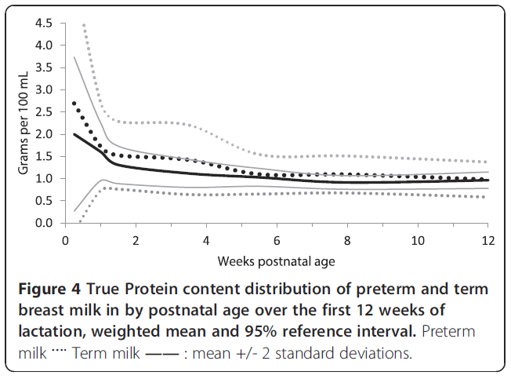
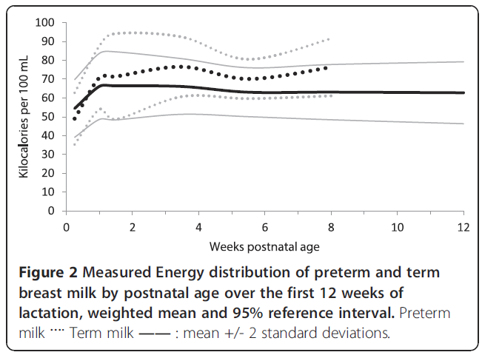
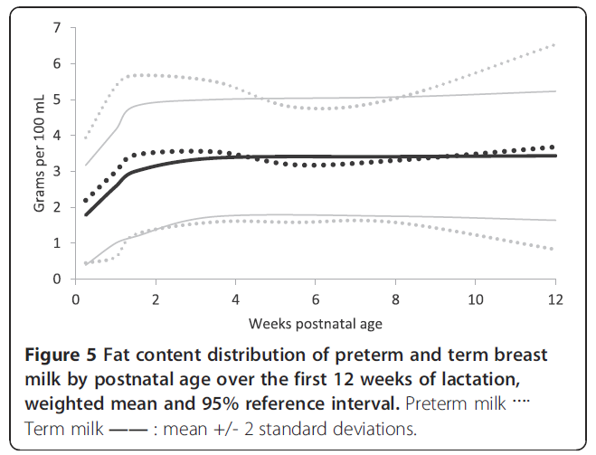
Human Milk Variability
Preterm milk has more protein, fat & calories but not more Ca and P than term milk.
Gidrewicz, Fenton 2014

Slide 25
RCTs: Individualizing Breast Milk Fortification
Author | Criteria | Fortification | Outcome
Protein supplementation
Maas 2017 | < 32 wks or < 1500 g N = 60 MOM or DM | Protein added to BM: Individualized (N=15) to 4.3 g/kg/day 1.8 g/100 ml (N=15) 1 g/100 ml (N=30) | No difference in weight gain, lower leg growth, FOC by discharge
Doege 2007 | <28 wks OMM >80% feeds x 3 wk N = 120 >80% MOM at 3wks | 200 ml/kg/day EBM with individualized protein fortification (3.5-4 g/kg/day) 50-170 ml/kg/day formula (80 cal/dL, 2.3 g/dL) until 38 wk PMA | Similar weight at 38 weeks PMA
Polberger 1999 | 920-1750 g N =32 Tolerating 150 ml/kg/day MOM or DM | Individualized fortification to 3.5 g/kg/day Bovine whey Human milk protein | Similar growth (weight, length, FOC) and lab values

Slide 26
RCTs: Individualizing Breast Milk Fortification
Author | Criteria | Fortification | Outcome
Fat supplementation
Hair 2014, 2016 | 750-1250 g N = 78 MOM or DM | Individualized with HM fat to reach 20 cal/oz vs. Standard fortification | Increased weight gain velocity by 1.6 g x kg⁻¹ x day⁻¹ & linear growth by 0.2 cm x week⁻¹, discharged earlier
Protein and energy supplementation
McLeod 2016 | <30 wk MOM or DM N=40 | Max 4 g protein/100 ml Duocal max 3 g/100 ml in intervention (from birth) vs. 2 g/100 ml in control group Target 3.8-4.4 g/kg/day and 130-150 cal/kg/day | No difference in wgt gain to discharge, % Fat mass No difference in protein, cal intake Measured protein 1.6 g/100 ml > assumed 1.4 g/100 ml
Rochow 2017 | <30 wk Full enteral feed MOM or DM N=103 | Validated NIRS measurement 3 wk supplementation to protein 4.5 g/kg/day, CHO 13.2 and fat 6.6 g/kg/day | Increased weight, length, FM, FFM to 36wks PMA; Higher BUN and glucose on day 14; higher intake of protein, CHO and fat. Weight gain associated with in protein intake and protein: energy intake
Notes:
,

Slide 27
DSMC: Adverse Events
Definitions:
NEC | Stage > II NEC
Death | In NICU or afterwards
Sepsis | Positive blood culture; if CONS: needs 2 positive with 7 day treatment
Feeding intolerance | NPO for 24 hours for distention, vomiting or residuals
High BUN | BUN: creatinine ratio > 60:1 or BUN > 80 during 1st wk of life
Low serum bicarbonate | Bicarbonate < 10

Slide 28
DSMC: Stopping Rules
• Less than 10 patients recruited in 12 months
• Mortality in enrolled patients significantly higher than in
non-enrolled patients (P<0.01)
• More frequent necrotizing enterocolitis in enrolled patients (P<0.01)

Slide 29
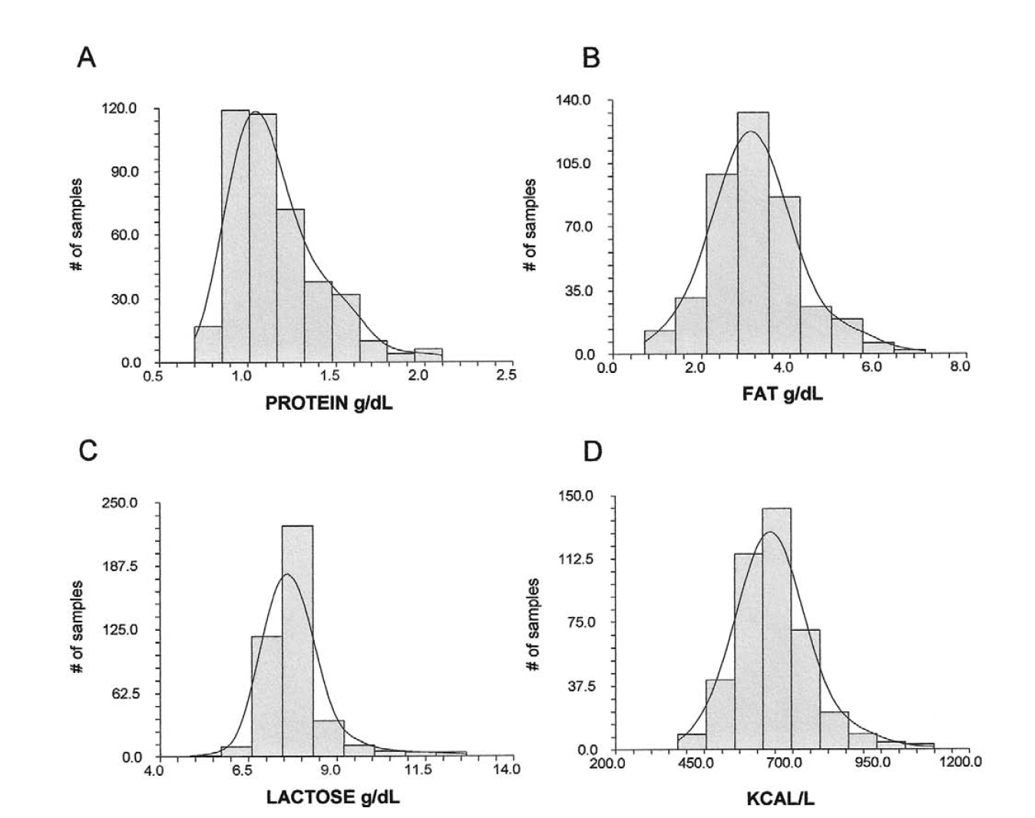
J Amer Dietetic Assoc 2009

Slide 30
Triplicate Measurements 11/6/15
FAT
PROTEIN
+2SD
Mean
-2SD
NIR - Gold Standard
Mean Concentration (GS & NIR) (g/dL)
LACTOSE
Mean Concentration (GS & NIR) (g/dL)
Error vs. Gold Standard
Macro-nutrient | Error +SD (g/dL) | Error + SD (% of gold standard) | SE of the Prediction (g/dL)
Fat | 0.00+0.17 | 0.9+ 8.1% | 0.17
Protein | 0.00+0.07 | 0.8+10.4% | 0.07
Lactose | 0.00+0.19 | 0.1+ 2.7% | 0.19
NIR - Gold Standard
Bias- and skew-corrected
Mean Concentration (GS & NIR) (g/dL)

