Slide 1
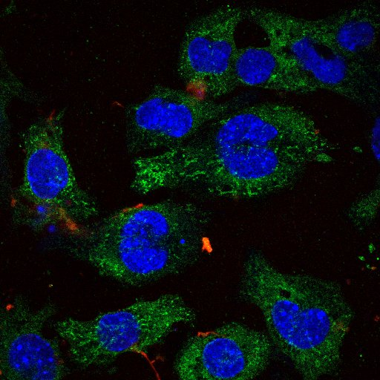
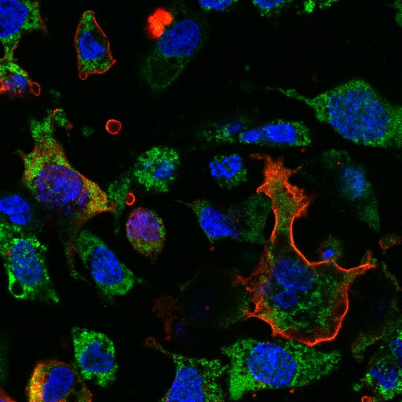
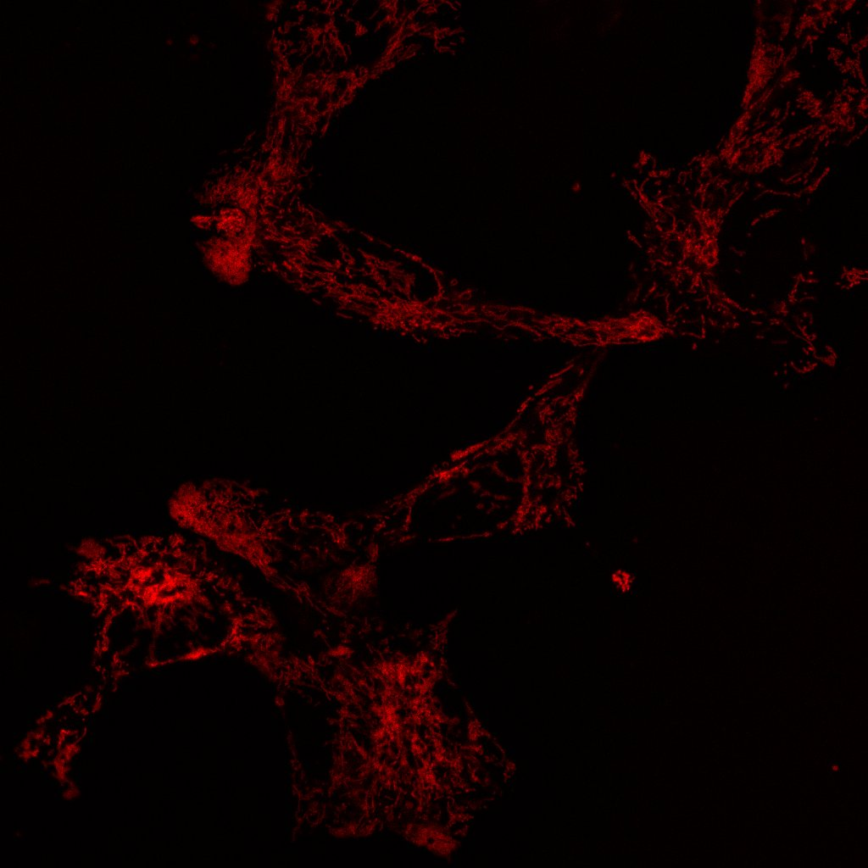
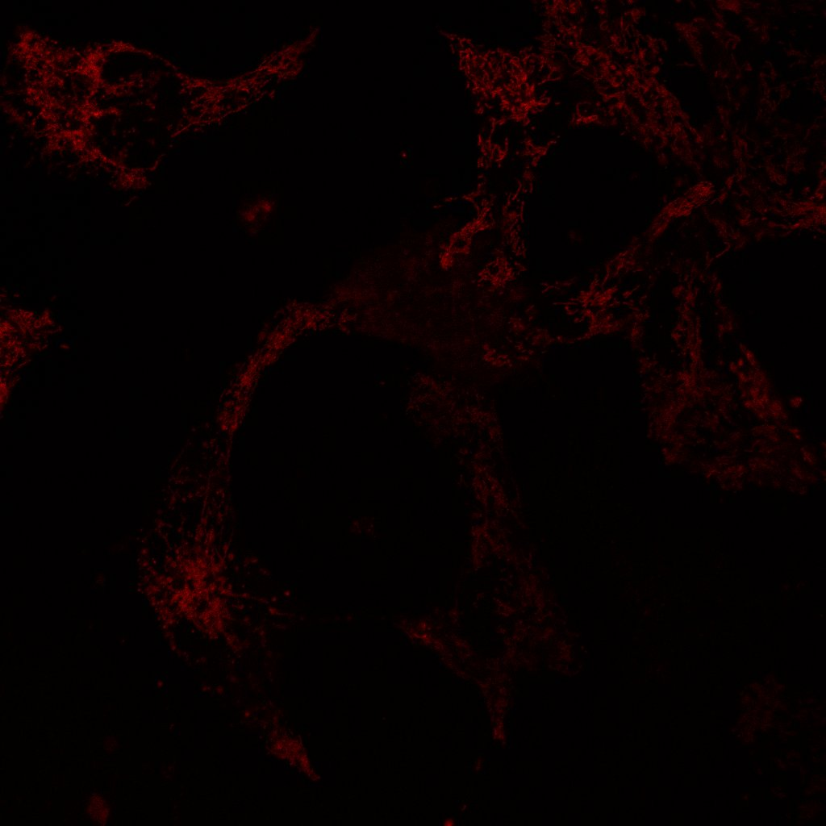
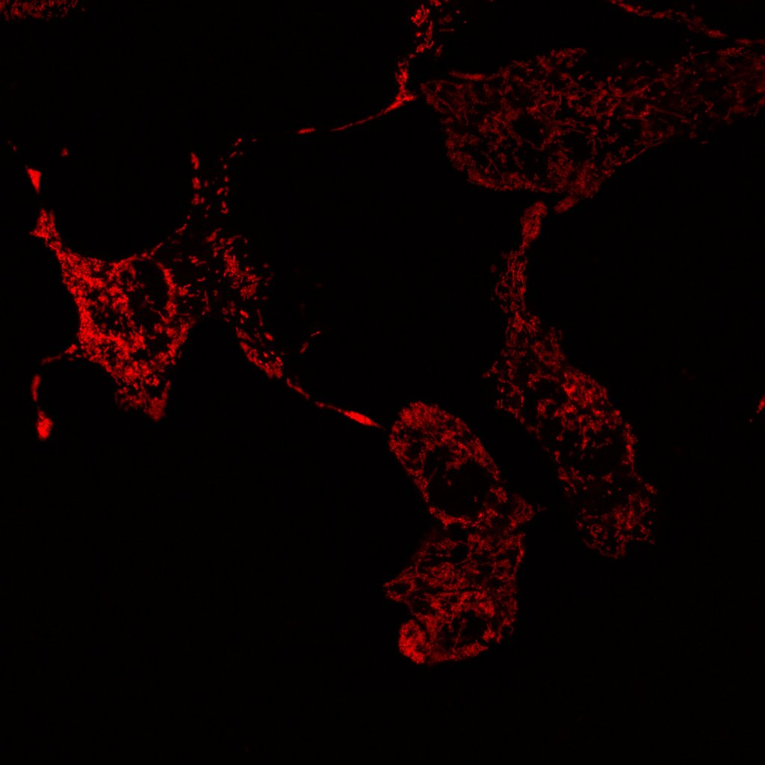
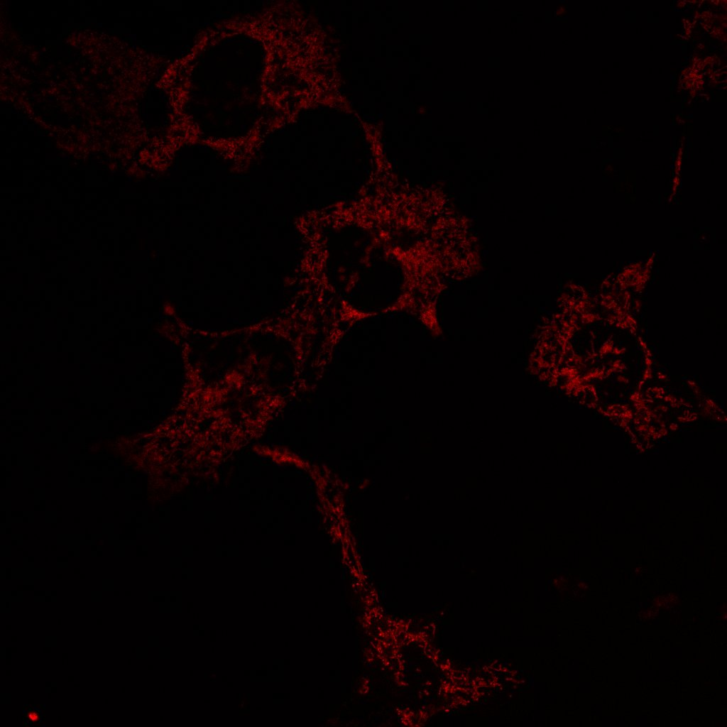
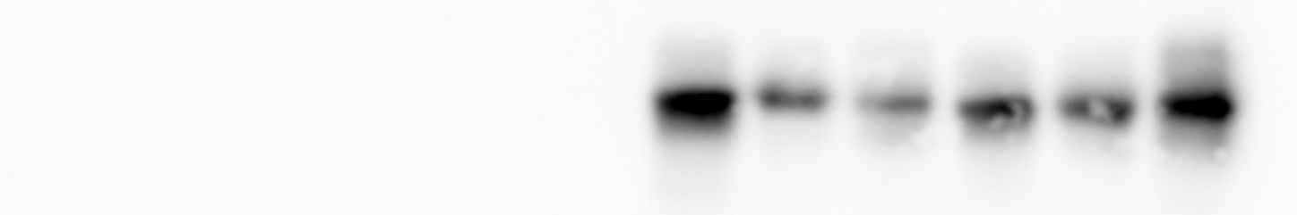
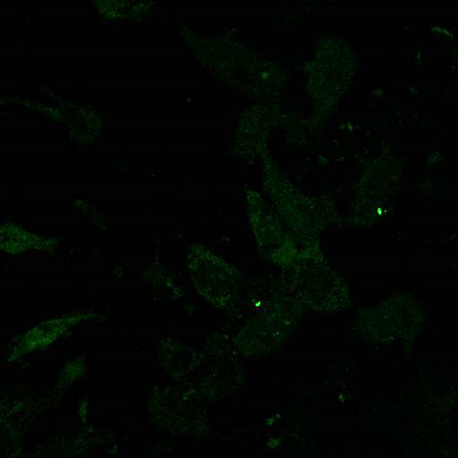
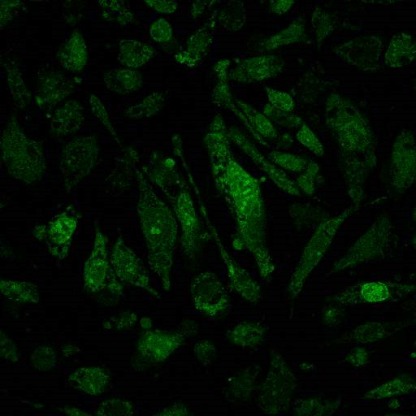
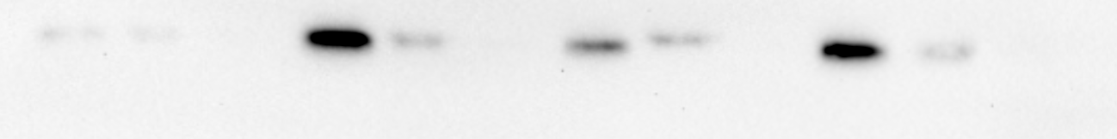
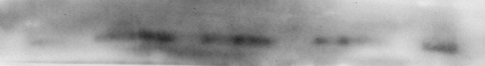
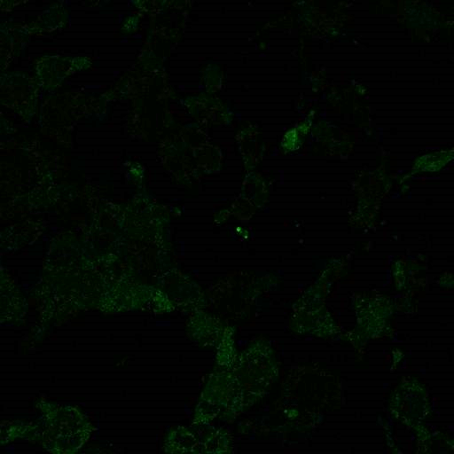
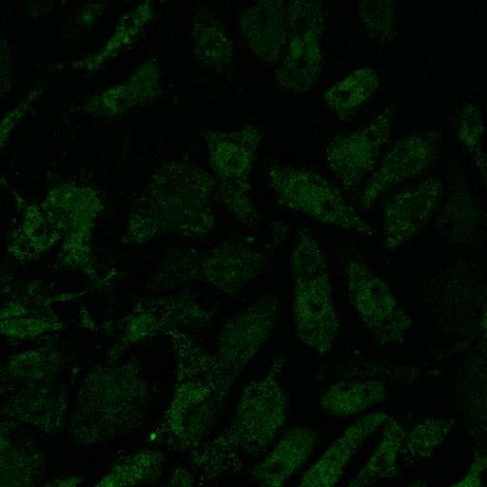
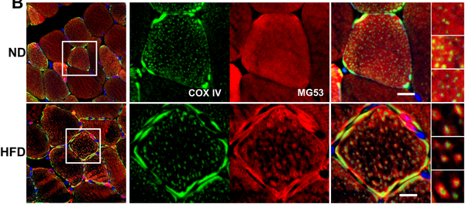
Exogenous MG53 Protects Adult Mouse Cardiomyocytes by Preventing Mitochondrial Damage in Response to Oxidative Stress
Kristyn Gumpper, Xinyu Zhou, Ki Ho Park, Renzhi Han, Hua Zhou, Pei-Hui Lin, Jianjie Ma
Department of Surgery, The Ohio State University, Columbus, OH
b
INTRODUCTION
Ischemic heart disease is a major cause of mortality and morbidity world-wide; often associated with other chronic diseases such as Type-II Diabetes and Obesity.
Ischemia can cause a loss of healthy mitochondria – leading to cell death and tissue malfunction
rhMG53 translocates to mitochondria after hypoxia, energy depletion, and acidosis
rhMG53 preserves mitochondrial membrane potential
rhMG53 reduces mt-cpYFP FLASH in isolated cardiomyocytes
Normoxia
HEDA
H/R Control
H/R+rhMG53
MG53 (TRIM72)
Highly expressed in human skeletal muscle and modestly in other tissues
  Is secreted into the blood stream
MG53 is highly involved in cell membrane repair associated with changes in oxidative states inside the cell [1-3] mg53 -/- mice are more susceptible to ischemia-reperfusion (I/R) injury than wild-type mice
Pre- and post-injury treatment with recombinant human MG53 (rhMG53) in mice and pigs reduces both infarct size and fibrosis while restoring cardiac function [3-4]
Control
H₂O₂
rhMG53 + H₂O₂
BSA + H₂O₂
Cardiomyocytes derived from mt-cpYFP transgenic mice were isolated and subjected to hypoxia for 6 hours and reoxygenation for 30 minutes (H/R) ± 10ug/mL rhMG53. Time series confocal images were collected. Top: representative confocal images. Bottom: 3D projection of the events and magnitude collected during the time lapse. rhMG53 effectively reduces superoxide flashes.
HL-1 cells (mouse atrial cardiomyocyte derived cell line) were subjected to either normoxia or hypoxia in PBS pH 6.7 without glucose to mimic physiological hypoxia, energy depletion, and acidosis (HEDA) with 10μg/mL rhMG53 for 24hour and stained for MG53 (red) or COX IV (green). There is the typical plasma membrane localization in the HEDA group. Additionally, MG53 signal surrounds COX IV on the mitochondria membrane.
HL-1 cells were treated with 300µM H₂O₂ for 1hr in unsupplemented Claycomb media. Media was exchanged to unsupplemented Claycomb media with or without 10μg/mL rhMG53 or BSA. After a 2hr recovery period, cells were stained with TMRE, imaged via a confocal microscope. TMRE integrated density was normalized to the average integrated intensity of the control group for each experiment. Adding 10ug/mL rhMG53 maintaining mitochondria membrane potential after H₂O₂ -induced oxidative stress.
QUESTIONS
How does MG53 enter cells for exogenous repair?
Does MG53 do more than membrane repair to protect cardiomyocytes from I/R injury?
Future Directions
In addition to preserving mitochondrial membrane potential and reducing superoxide accumulation,, it will be imperative to assess mitophagy and mitochondrial function
MG53 may be a useful therapeutic in preserving cardiac tissue after ischemic events
HYPOTHESIS
In addition to cell membrane repair, exogenous MG53 enters cardiomyocytes and can act as a myokine to protect cardiomyocytes by maintaining mitochondrial function through control of oxidative-stress induced mitophagy.
Control
BSA
rhMG53
HEDA
Control
HEDA
rhMG53 prevents accumulation of mitochondrial superoxides
T
C
M
T
C
M
T
C
M
T
C
M
MG53
References
Tubulin
1. Cai C, Masumiya H, Weisleder N, et al (2009) MG53 nucleates assembly of cell membrane repair machinery. Nat Cell Biol 11:56–64
2. Hwang M, Ko J-K, Weisleder N, Takeshima H, Ma J (2011) Redox-dependent oligomerization through a leucine zipper motif is essential for MG53-mediated cell membrane repair. Am J Physiol Cell Physiol 301:C106-14
3. Weisleder N, Takizawa N, Lin P, et al (2012) Recombinant MG53 protein modulates therapeutic cell membrane repair in treatment of muscular dystrophy. Sci Transl Med 4:139ra85
4. Liu J, Zhu H, Zheng Y, et al (2015) Cardioprotection of recombinant human MG53 protein in a porcine model of ischemia and reperfusion injury. J Mol Cell Cardiol 80:10–19
5. Ayodele Adesanya TM, Russell M, Ki B;, et al MG53 Protein Protects Aortic Valve Interstitial Cells From Membrane Injury and Fibrocalcific Remodeling. doi: 10.1161/JAHA.118.009960
6. Ma H, Liu J, Bian Z, Cui Y, Zhou X, et al. (2015) Effect of Metabolic Syndrome on Mitsugumin 53 Expression and Function. PLOS ONE 10(5): e0124128. https://doi.org/10.1371/journal.pone.0124128
rhMG53 translocates to mitochondria after oxidative damage from high fat diet
BSA
HEDA + BSA
COX IV
HL-1 cells that underwent normoxia or HEDA were fractionated. Mitochondria and cytoplasmic fractions were probed for MG53, COX IV and tubulin. There is a clear increase in MG53 presence in the mitochondrial fraction.
rhMG53
HEDA + rhMG53
(Left) Skeletal muscle derived from mice fed either normal or high-fat diet dissected and stained with COXIV (green) or MG53 (red). Oxidative stress from a high fat diet induced MG53 translocation to mitochondria. (Ma, H. et al. PLoS One 2015)
HL-1 cells underwent either normoxia or HEDA for either 10μg/mL BSA or rhMG53 for 24hours. Cells were treated with MitoSOX Red and imaged on a confocal microscope. rhMG53 was able to reduce superoxide release from mitochondria after hypoxia.
ACKNOWLEDGEMENTS
We would like to thank Drs. Jingsong Zhou, and Jae-Kyun Ko for their assistance on this project.
This project was funded in part by an AHA Pre-Doctoral Fellowship (18PRE34030430) awarded to Kristyn Gumpper and NIH RO1 grants (DK106394 and AR070752) awarded to Jianjie Ma
Questions? Please email: Gumpper.1@osu.edu

